Slide 1
Ransac, Homography Estimation, and Image Stitching
Readings:
Szeliski Chapter 4, 6, 9
Kun@SYSU

Slide 2
Key points（2 algorithms）
1. Ransac algorithm for Matching
2. DLT algorithm for Homography Estimation

Slide 3
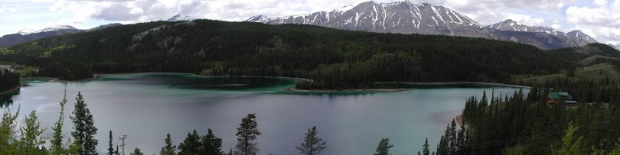
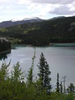
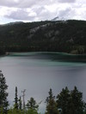
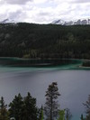
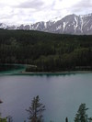
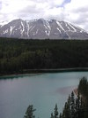
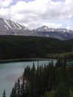
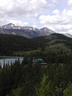
Image Stitching and Panoramas

Slide 4
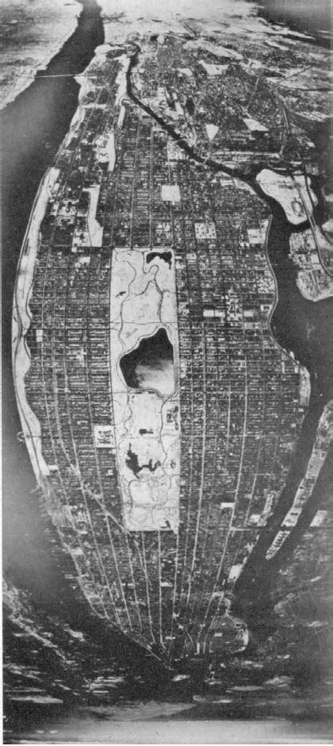
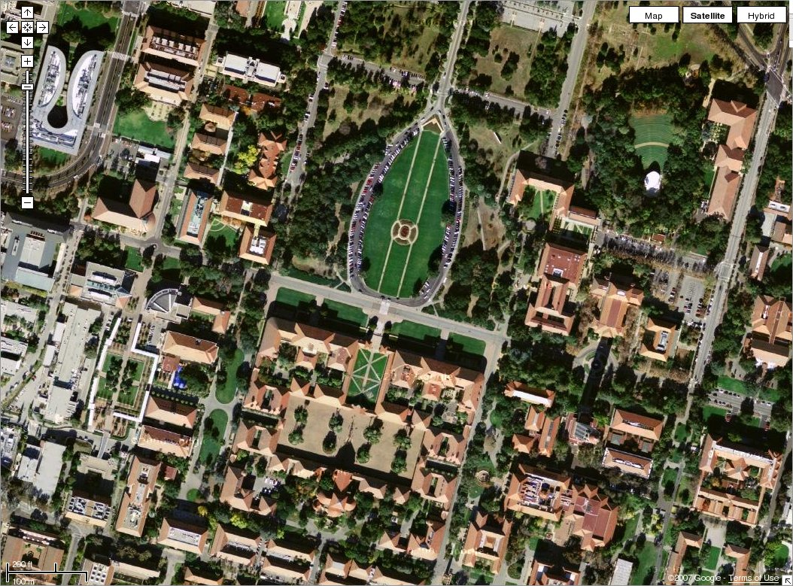
Why Panoramas ?
Cartography: stitching aerial images to make maps
Manhattan, 1949

Slide 5

Why Panoramas ?
Virtual reality: a sense of being there
Demo: Quicktime VR [Chen & Williams 95]

Slide 6
百度街景（SYSU）
http://map.baidu.com/?newmap=1&ie=utf-8&s=s%26wd%3D%E4%B8%AD%E5%B1%B1%E5%A4%A7%E5%AD%A6#panoid=01004800001312181312488125N&panotype=street&heading=56.51282737766599&pitch=-6.261775733265154&l=15&tn=B_NORMAL_MAP&sc=0&newmap=1&shareurl=1&pid=01004800001312181312488125N&psp=%7B%22PanoModule%22%3A%7B%22markerUid%22%3A%2229da5a5c5df245c81b94c69c%22%7D%2C%22PoiInfoPanelModule%22%3A%7B%22uid%22%3A%2229da5a5c5df245c81b94c69c%22%7D%7D

Slide 7
Image Alignment Algorithm Overview
Given images A and B
Compute image features for A and B
Match features between A and B
Compute homography between A and B using least squares on set of matches
What could go wrong?

Slide 8
Feature Matching and RANSAC

Slide 9
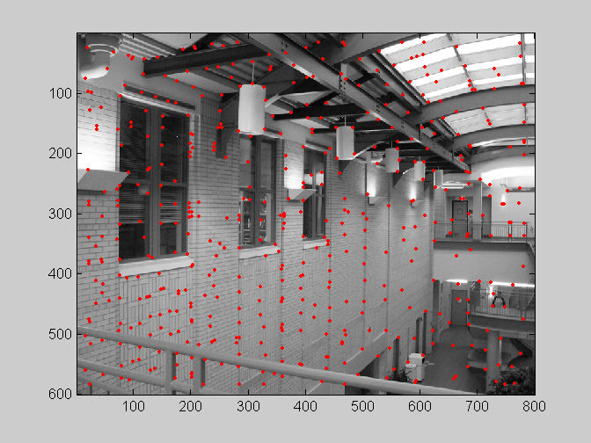
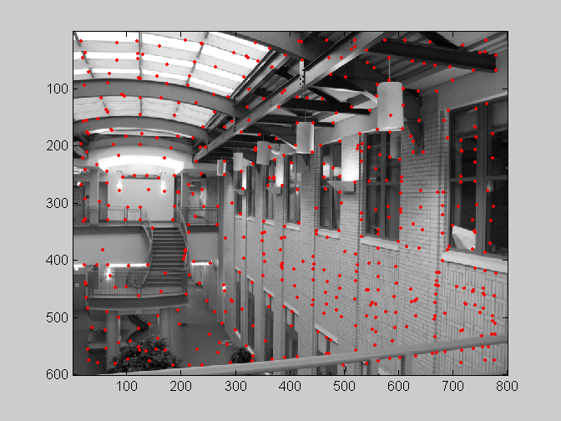
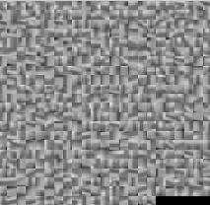
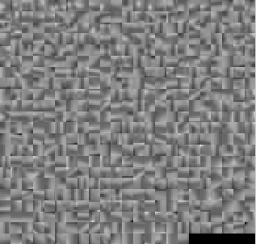
Feature matching
?

Slide 10
Feature matching
Exhaustive search
for each feature in one image, look at all the other features in the other image(s)
Hashing
compute a short descriptor from each feature vector, or hash longer descriptors (randomly)
Nearest neighbor techniques
kd-trees and their variants

Slide 11
Feature-space outlier rejection
Let’s not match all features, but only these that have “similar enough” matches?
How can we do it?
SSD(patch1,patch2) < threshold
How to set threshold?

Slide 12
Feature-space outlier rejection
A better way [Lowe, 1999]:
1-NN: SSD of the closest match
2-NN: SSD of the second-closest match
Look at how much better 1-NN is than 2-NN, e.g. 1-NN/2-NN
That is, is our best match so much better than the rest?

Slide 13
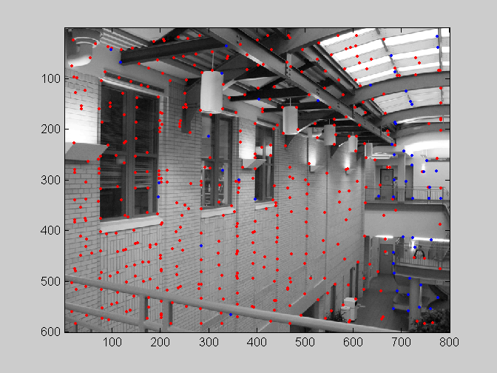
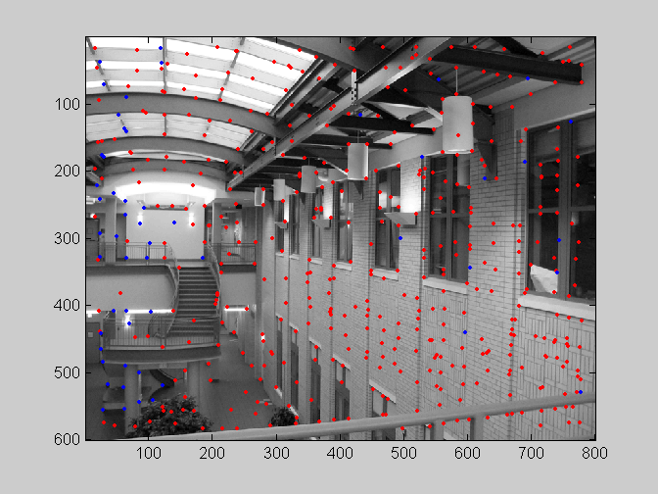
Feature-space outliner rejection
Can we now compute H from the blue points?
No! Still too many outliers…
What can we do?

Slide 14
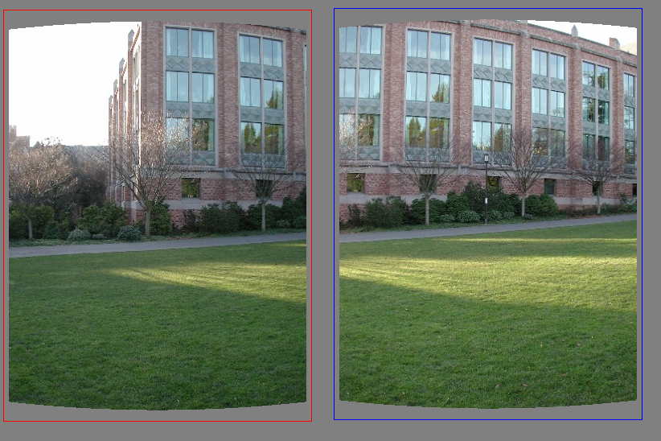
Matching features
What do we do about the “bad” matches?

Slide 15
RAndom SAmple Consensus
Select one match, count inliers

Slide 16
RAndom SAmple Consensus
Select one match, count inliers

Slide 17
Least squares fit
Find “average” translation vector

Slide 18

Outliers
outliers
inliers
SSD(p_{i}’, H p_{i})< ε

Slide 19
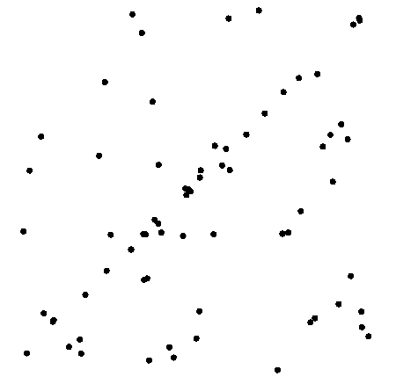
Example: line fitting

Slide 20
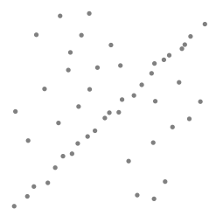
Robustness
Let’s consider a simpler example… linear regression
How can we fix this?
Problem: Fit a line to these datapoints
Least squares fit

Slide 21
Counting inliers

Slide 22
Counting inliers
Inliers: 3

Slide 23
Counting inliers
Inliers: 20

Slide 24
How do we find the best line?
Unlike least-squares, no simple closed-form solution
Hypothesize-and-test
Try out many lines, keep the best one
Which lines?

Slide 25
Translations

Slide 26
RAndom SAmple Consensus
Select one match at random, count inliers

Slide 27
RAndom SAmple Consensus
Select another match at random, count inliers

Slide 28
RAndom SAmple Consensus
Output the translation with the highest number of inliers

Slide 29
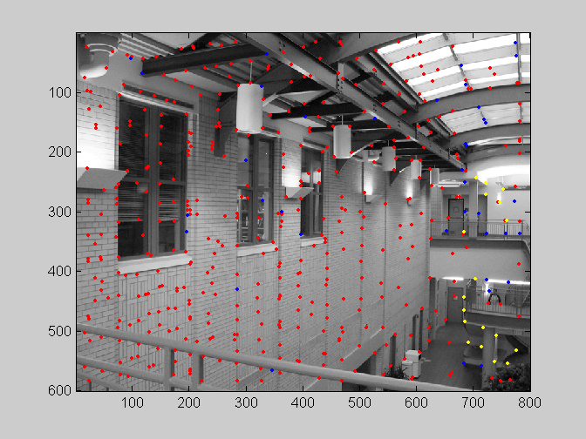
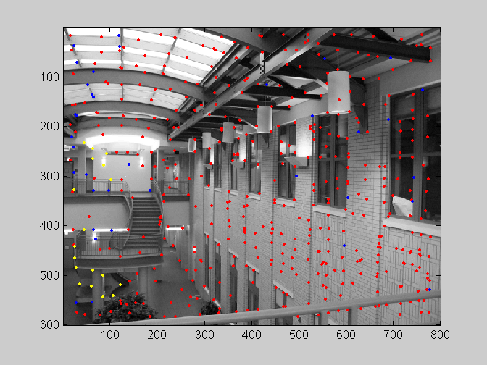
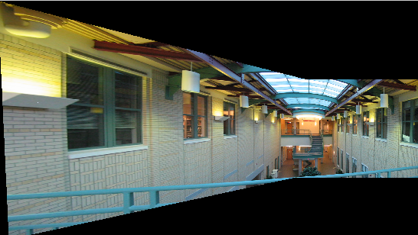
RANSAC

Slide 30
RANSAC
Idea:
All the inliers will agree with each other on the translation vector; the (hopefully small) number of outliers will (hopefully) disagree with each other
RANSAC only has guarantees if there are < 50% outliers
“All good matches are alike; every bad match is bad in its own way.”
– Tolstoy via Alyosha Efros

Slide 31
RANSAC
Inlier threshold related to the amount of noise we expect in inliers
Often model noise as Gaussian with some standard deviation (e.g., 3 pixels)
Number of rounds related to the percentage of outliers we expect, and the probability of success we’d like to guarantee
Suppose there are 20% outliers, and we want to find the correct answer with 99% probability
How many rounds do we need?

Slide 32
RANSAC
y translation
set threshold so that, e.g., 95% of the Gaussian
lies inside that radius
x translation

Slide 33
RANSAC
Back to linear regression
How do we generate a hypothesis?
y
x

Slide 34
RANSAC
Back to linear regression
How do we generate a hypothesis?
y
x

Slide 35
RANSAC
General version:
Randomly choose s samples
Typically s = minimum sample size that lets you fit a model
Fit a model (e.g., line) to those samples
Count the number of inliers that approximately fit the model
Repeat N times
Choose the model that has the largest set of inliers

Slide 36
RANSAC for estimating homography
RANSAC loop:
Select four feature pairs (at random)
Compute homography H (exact)
Compute inliers where SSD(p_{i}’, H p_{i})< ε
Keep largest set of inliers
Re-compute least-squares H estimate on all of the inliers

Slide 37
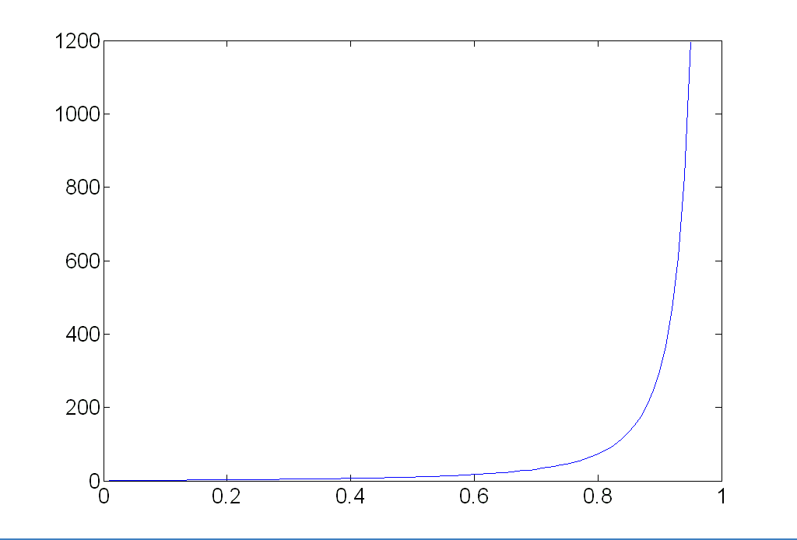
How many rounds?
If we have to choose s samples each time
with an outlier ratio e
and we want the right answer with probability p
 | proportion of outliers e
s | 5% | 10% | 20% | 25% | 30% | 40% | 50%
2 | 2 | 3 | 5 | 6 | 7 | 11 | 17
3 | 3 | 4 | 7 | 9 | 11 | 19 | 35
4 | 3 | 5 | 9 | 13 | 17 | 34 | 72
5 | 4 | 6 | 12 | 17 | 26 | 57 | 146
6 | 4 | 7 | 16 | 24 | 37 | 97 | 293
7 | 4 | 8 | 20 | 33 | 54 | 163 | 588
8 | 5 | 9 | 26 | 44 | 78 | 272 | 1177
p = 0.99
Source: M. Pollefeys

Slide 38
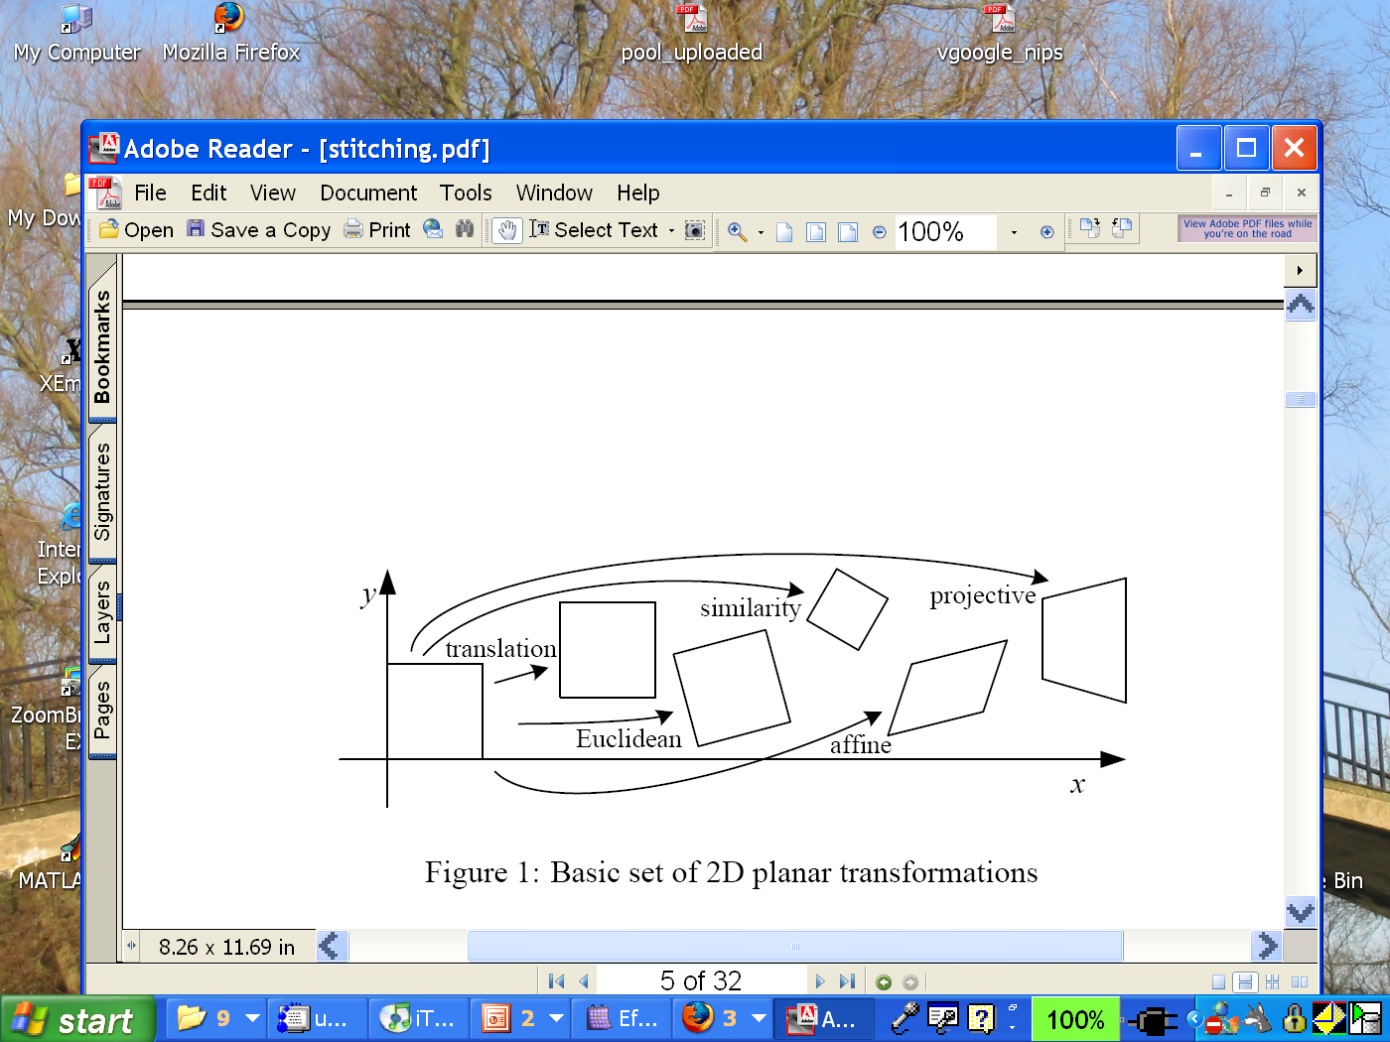
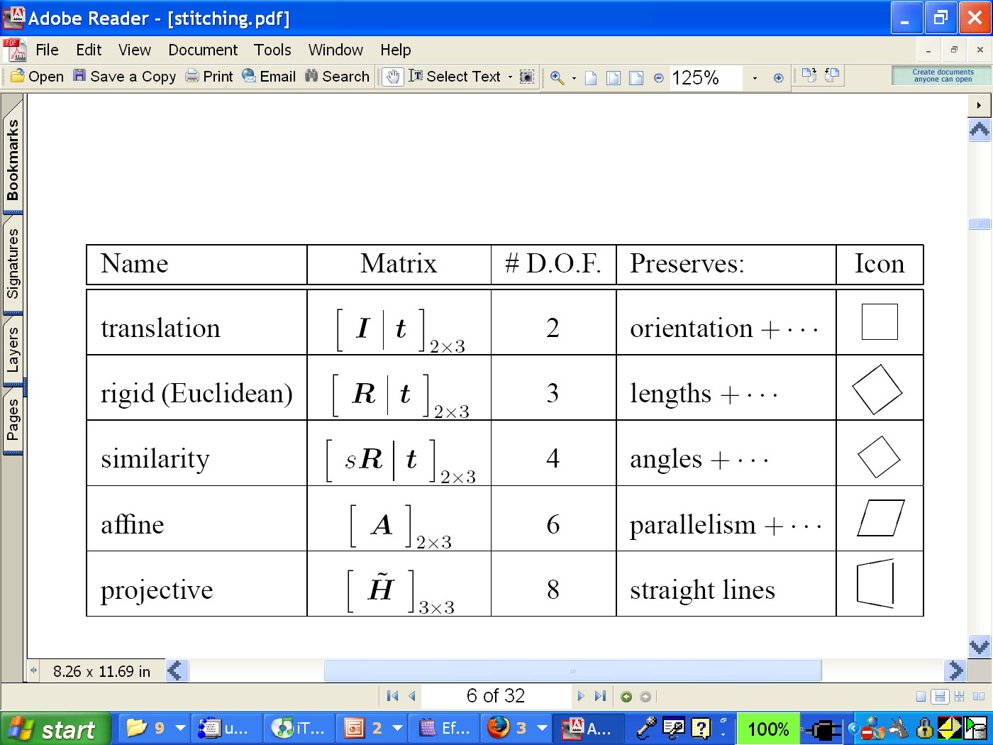
How big is s?
For alignment, depends on the motion model
Here, each sample is a correspondence (pair of matching points)

Slide 39
RANSAC pros and cons
Pros
Simple and general
Applicable to many different problems
Often works well in practice
Cons
Parameters to tune
Sometimes too many iterations are required
Can fail for extremely low inlier ratios
We can often do better than brute-force sampling

Slide 40
Final step: least squares fit
Find average translation vector over all inliers

Slide 41
RANSAC
An example of a “voting”-based fitting scheme
Each hypothesis gets voted on by each data point, best hypothesis wins
There are many other types of voting schemes
E.g., Hough transforms…

Slide 42

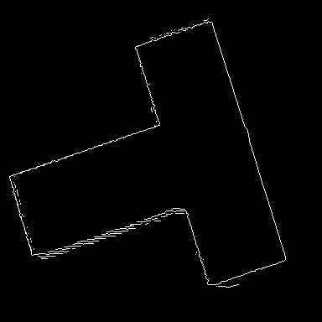
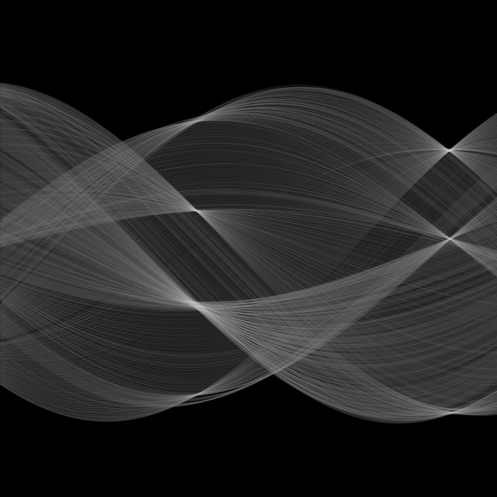
Hough transform
ρ
θ

Slide 43
RANSAC for estimating homography
RANSAC loop:
Select four feature pairs (at random)
Compute homography H (exact)
Compute inliers where SSD(p_{i}’, H p_{i})< ε
Record the largest set of inliers so far
Re-compute least-squares H estimate on the largest set of the inliers

Slide 44
RANSAC in general
RANSAC = Random Sample Consensus
an algorithm for robust fitting of models in the presence of many data outliers
Compare to robust statistics
Given N data points x_{i}, assume that mjority of them are generated from a model with parameters Θ, try to recover Θ.

Slide 45
RANSAC algorithm
Run k times:
(1) draw n samples randomly
(2) fit parameters Θ with these n samples
(3) for each of other N-n points, calculate
its distance to the fitted model, count the
number of inlier points, c
Output Θ with the largest c
How many times?
How big?
Smaller is better
How to define?
Depends on the problem.

Slide 46
How to determine k
n: number of samples drawn each iteration
p: probability of real inliers
P: probability of at least 1 success after k trials
n samples are all inliers
a failure
failure after k trials
n | p | k
3 | 0.5 | 35
6 | 0.6 | 97
6 | 0.5 | 293
for P=0.99

Slide 47
Application for Automatic image stitching

Slide 48




RANSAC for Homography

Slide 49
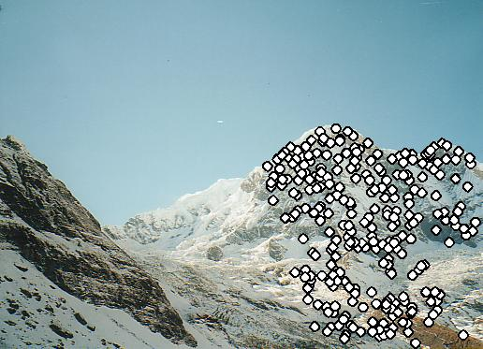
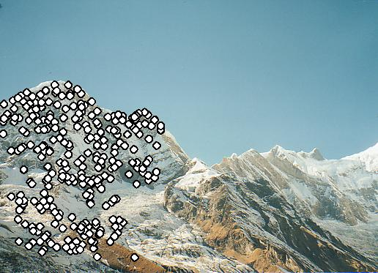
RANSAC for Homography

Slide 50

Automatic image stitching

Slide 51
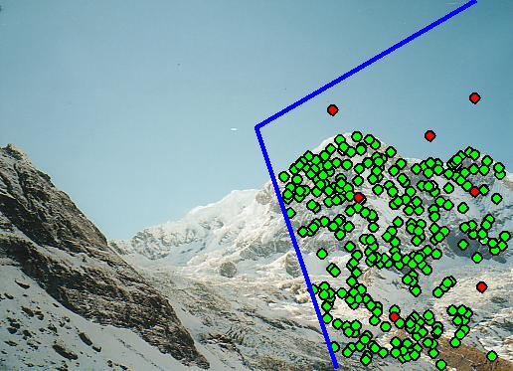
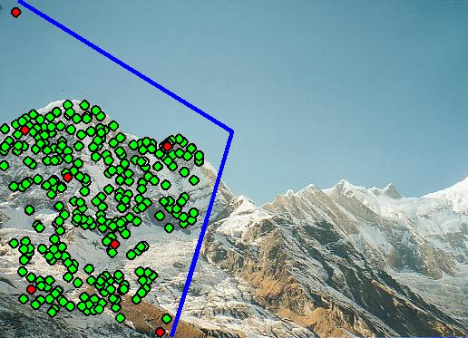
Probabilistic model for verification

Slide 52
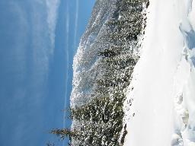
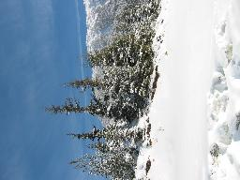

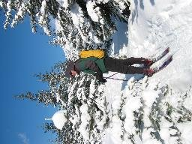
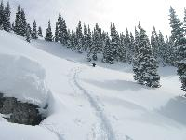
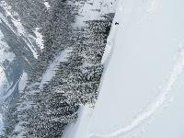
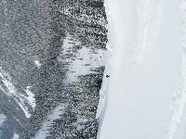
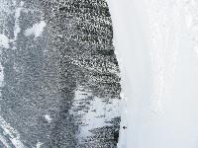
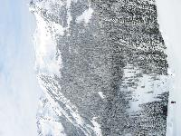
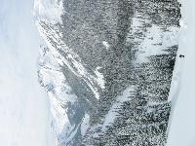
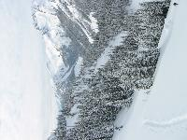
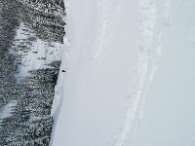
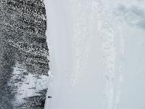
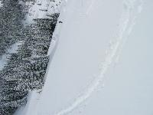
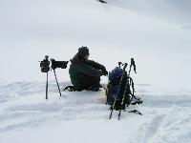
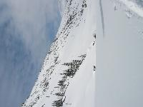
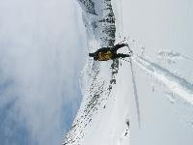
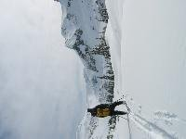
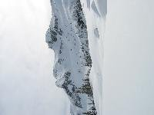
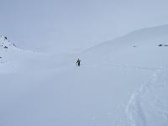




Automatic image stitching

Slide 53
Automatic image stitching

Slide 54
Homography Estimation

Slide 55



Homography for Rotation
Parameterise each camera by rotation and focal length
This gives pairwise homographies

Slide 56





































Bundle Adjustment
New images initialised with rotation, focal length of best matching image

Slide 57

Bundle Adjustment
New images initialised with rotation, focal length of best matching image

Slide 58


Multi-band Blending
Burt & Adelson 1983
Blend frequency bands over range ∝ λ
More reference: Szeliski, Section of 3.3.5

Slide 59


























Results

Slide 60
Computing homography by DLT
“Multiple View Geometry in Computer Vision”, Second Edition. Richard Hartley and Andrew Zisserman, Cambridge University Press, March 2004.
Chapter 4. pp 89- 91

Slide 61

Computing homography
Assume we have four matched points: How do we compute homography H?
Direct Linear Transformation (DLT)

Slide 62

Computing homography

Slide 63

Computing homography

Slide 64

Computing homography

Slide 65

Computing homography

Slide 66

Computing homography

Slide 67

Computing homography
Assume we have matched points with outliers: How do we compute homography H?
Automatic Homography Estimation with RANSAC
Choose number of samples N

Slide 68
Computing homography
Assume we have matched points with outliers: How do we compute homography H?
Automatic Homography Estimation with RANSAC
Choose number of samples N
Choose 4 random potential matches
Compute H using normalized DLT
Project points from x to x’ for each potentially matching pair:
Count points with projected distance < t
t ~= 6 σ ; σ is measurement error (1-3 pixels)
Repeat steps 2-5 N times
Choose H with most inliers

Slide 69
















Algorithm overview

Slide 70
Algorithm overview

Slide 71
Algorithm overview

Slide 72
Algorithm overview

Slide 73
Algorithm overview
(DLT)

Slide 74
Algorithm overview
(DLT)

Slide 75
Finding the panoramas

Slide 76
Finding the panoramas

Slide 77
Algorithm overview

Slide 78
Algorithm overview

Slide 79
Algorithm overview

Slide 80

Get you own copy!
[Brown & Lowe, ICCV 2003]
[Brown, Szeliski, Winder, CVPR’05]

Slide 81
How well does this work?
Test on 100s of examples…

Slide 82
How well does this work?
Test on 100s of examples…
…still too many failures (5-10%) for consumer application

Slide 83


Matching Mistakes: False Positive

Slide 84


Matching Mistakes: False Positive

Slide 85

Matching Mistakes: False Negative
Moving objects: large areas of disagreement

Slide 86


Matching Mistakes
Accidental alignment
repeated / similar regions
Failed alignments
moving objects / parallax
low overlap
“feature-less” regions
No 100% reliable algorithm?

Slide 87
How can we fix these?
Tune the feature detector
Tune the feature matcher (cost metric)
Tune the RANSAC stage (motion model)
Tune the verification stage
Use “higher-level” knowledge
e.g., typical camera motions
Need a large training/test data set (panoramas)

